Slide 1
Online Sales Portal
Group 22​
Nisarg Upadhyaya
Pranav Rajput
Animesh Jha

Slide 2
PROBLEM DEFINITION
One-stop store for both the buyer and the seller.
Items have to be categorized
Sellers can upload items
Buyers can raise requests to buy items and negotiate
Entire platform is managed by users (managers), who can add/remove buyers, sellers, items and categories

Slide 3
SOFTWARE REQUIREMENT SPECIFICATION
Clearly laid out an overview of the major functions the product is expected to perform before detailing them out.
Separated the use cases between the buyer, seller and manager.
Assumptions laid out beforehand, specifically regarding the negotiations and payments interface.

Slide 4
COVERAGE
User profiles
Categorization of items
Upload item
Search for items
Buy requests
Negotiation*
Payments*
Check delivery constraints
Remove items
Audit
Remove Buyers
Remove Sellers
Remove Categories with no Items
Remove Categories with Items
* Payments and negotiations implemented using external communication means (email) as specified in the SRS

Slide 5
Technologies Used
Backend - Python, Flask and MongoEngine
Frontend - HTML, CSS, Bootstrap and Vue.js
Deployment Server - Heroku
Database Server - MongoDB Atlas

Slide 6
Why
Python?
Why MongoEngine?
Python is better suited than Java and C++ to create a web backend due to the presence of libraries like Flask and Django while also allowing object oriented design. Moreover we have prior experience of developing Flask based web apps.
PyMongo is the traditional choice for interacting with a MongoDB database, however, cosidering we had to work with python objects we looked for a Object-Document Mapper and found MongoEngine to be an ideal one. It is well-maintained, has good documentation and intuitive semantics for querying and provides several validation features which would help us in the implementation.

Slide 7
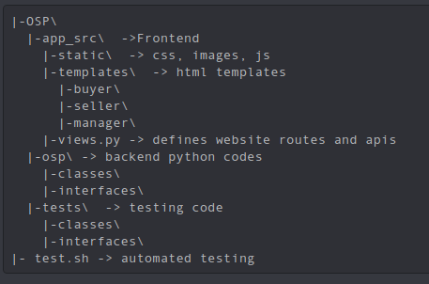
Code Base Structure https://github.com/kodekuzuri/OSP/

Slide 8
Challenging Use Cases
While MongoEngine has its benefits, there is a difference between what the user gives as input to create a database entry and what it stores, as the lib uses __init__ while querying the DB, it is not possible to use the constructor while retaining its readability. For this reason we created a separate createClass function and used it to create and upload objects.
Handling the uploading of images was a challenging task while deployment. To fix this we used JavaScript methods to convert an uploaded image into base64 and sent that to the backend via a POST request, this was then resaved as an image using the tempfile module and then saved into the database.

Slide 9
Challenging Use Cases
Design choice to set items of deleted categories as UNK category, this however didn’t work. If we had instead used a cascaded delete, we would have been able to properly implement a bug free deleted category functionality. Currently it nullifies the category relationship but a dangling reference still remains in the item.
Flask provides inbuilt login decorators which allowed us to maintain user sessions and allow only logged in users to access the site functionality. However, to prevent one type of user from accessing the functionality of another we had to write custom decorators to further restrict the functionalities depending on the logged in user.

Slide 10
Future Improvements
Better UI , accessibility for users who can't perceive all colors equally. Make website mobile optimised
Better hosting and database services for faster load times.
Fix deletion of categories with existing items via a better design choice or debugging the existing code.
Integrate a payment interface into the portal.
Can use a notification system instead of email.
Store password hashes for improved security.

Slide 11
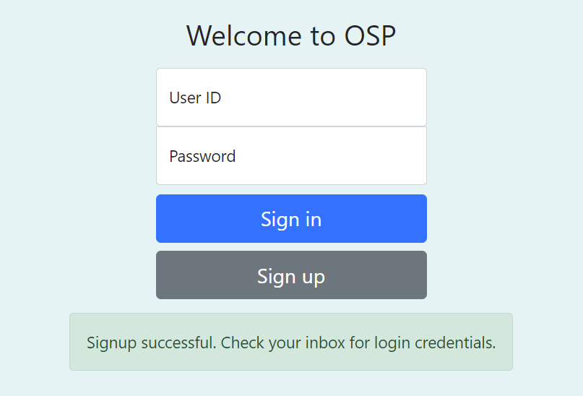
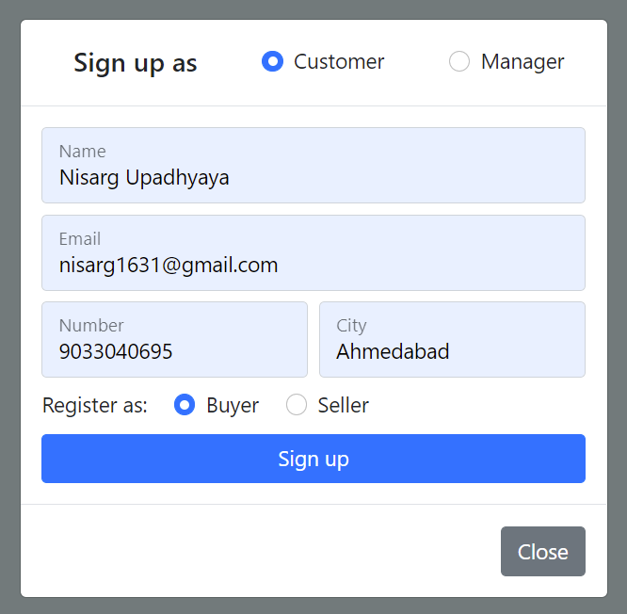
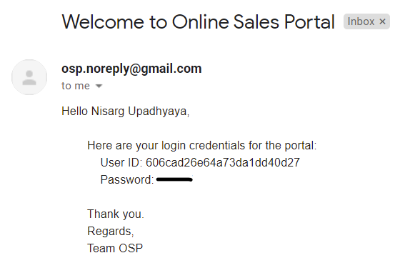

Slide 12
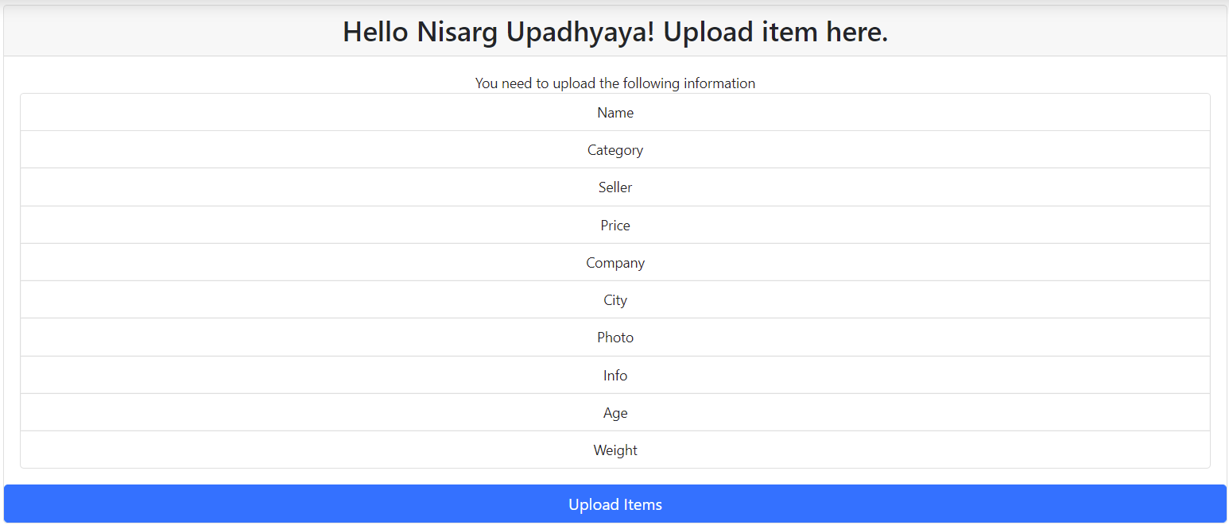
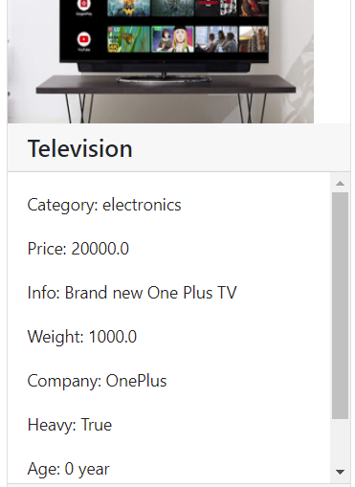
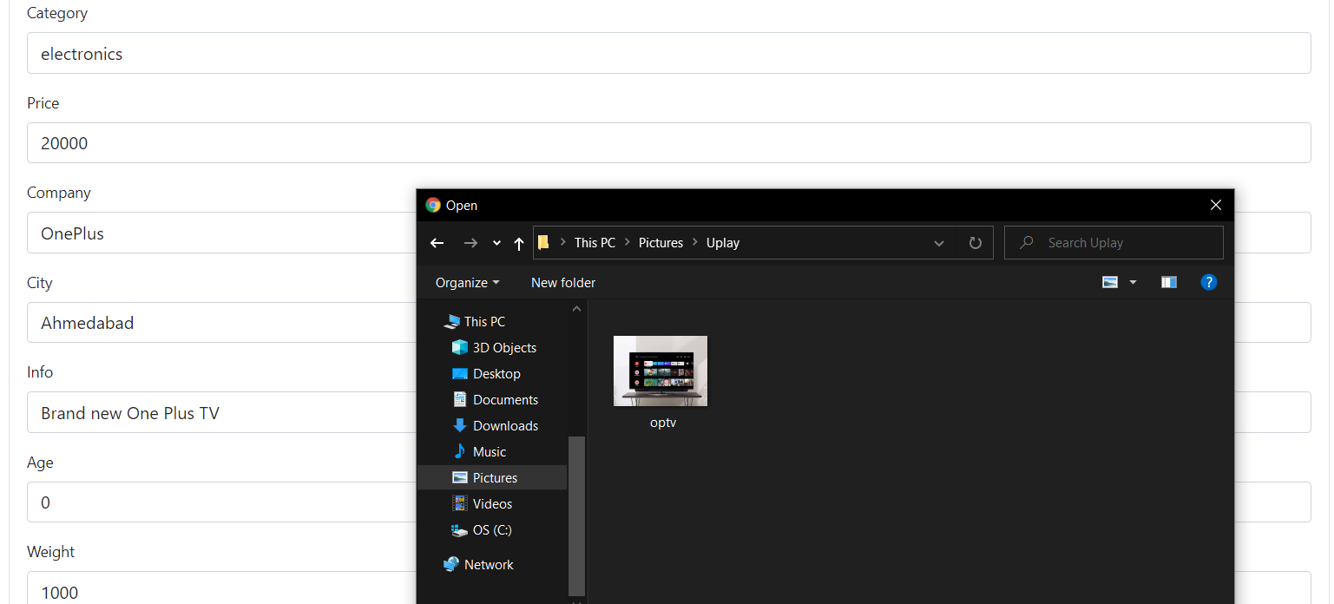

Slide 13
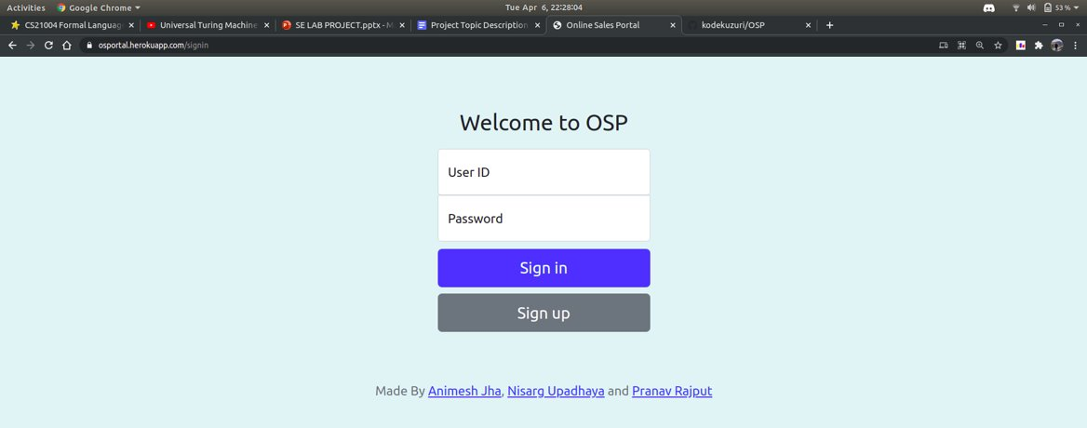
Demo
https://osportal.herokuapp.com/

